Slide 1
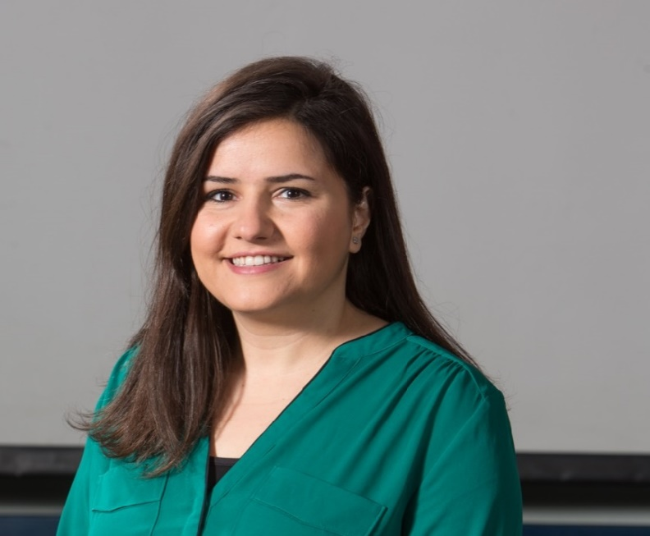
Fadia El-issa is a lecturer at Princess Sumaya University for Technology. Fadia teaches several engineering courses along with “Technical Writing and Communication Skills” course to engineering and computer science students. She considers herself an advocate for education reform and believes that proper communication is the foundation for personal development and key to career success. Fadia loves to work with youth, she attended lots of leadership workshops and conferences during her university life, and wants to pass her experience on to others.
Fadia B. El-issa

